Slide 1




RRTC on Advancing Employment for Individuals with IDD
Individual and family knowledge and engagement
Effective employment supports
Organizational change for community providers
State-level policy and strategy

Slide 2
“Change is hard at first, messy in the middle and gorgeous at the end”
Robin Sharma

Slide 3

By: Jeff Gentry, Triangle
www.peoplewithability.org

Slide 4



Slide 5



Slide 6


Slide 7


Slide 8


The Stockdale Paradox
You must retain faith that you will prevail in the end, regardless of the difficulties.
AND, at the same time…
You must confront the most brutal facts of your current reality, whatever they might be.

Slide 9
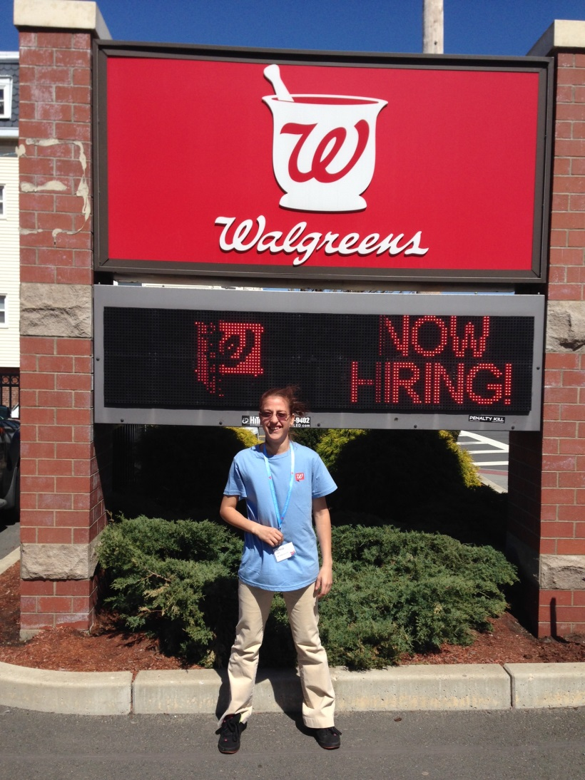
We are not simply doing a job, we are responding to a calling to connect people of all abilities to careers and their communities
Yet, we realize that disability employment numbers have not markedly improved in 30 years and facility based non-work services are the fastest growing service in our industry
We must continue on towards the summit of full disability inclusion and employment. Keep an eye out for the cairns of clear goals, clear procedures, and clear communication that mark the way

Slide 10
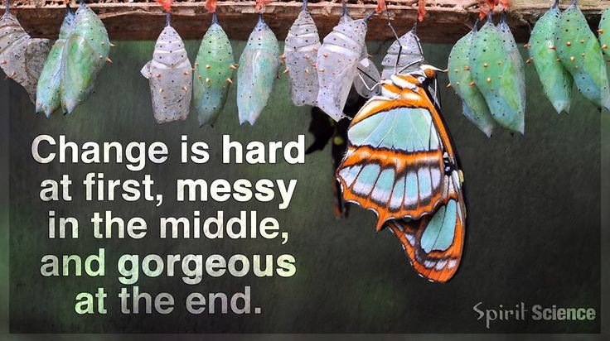

Slide 11
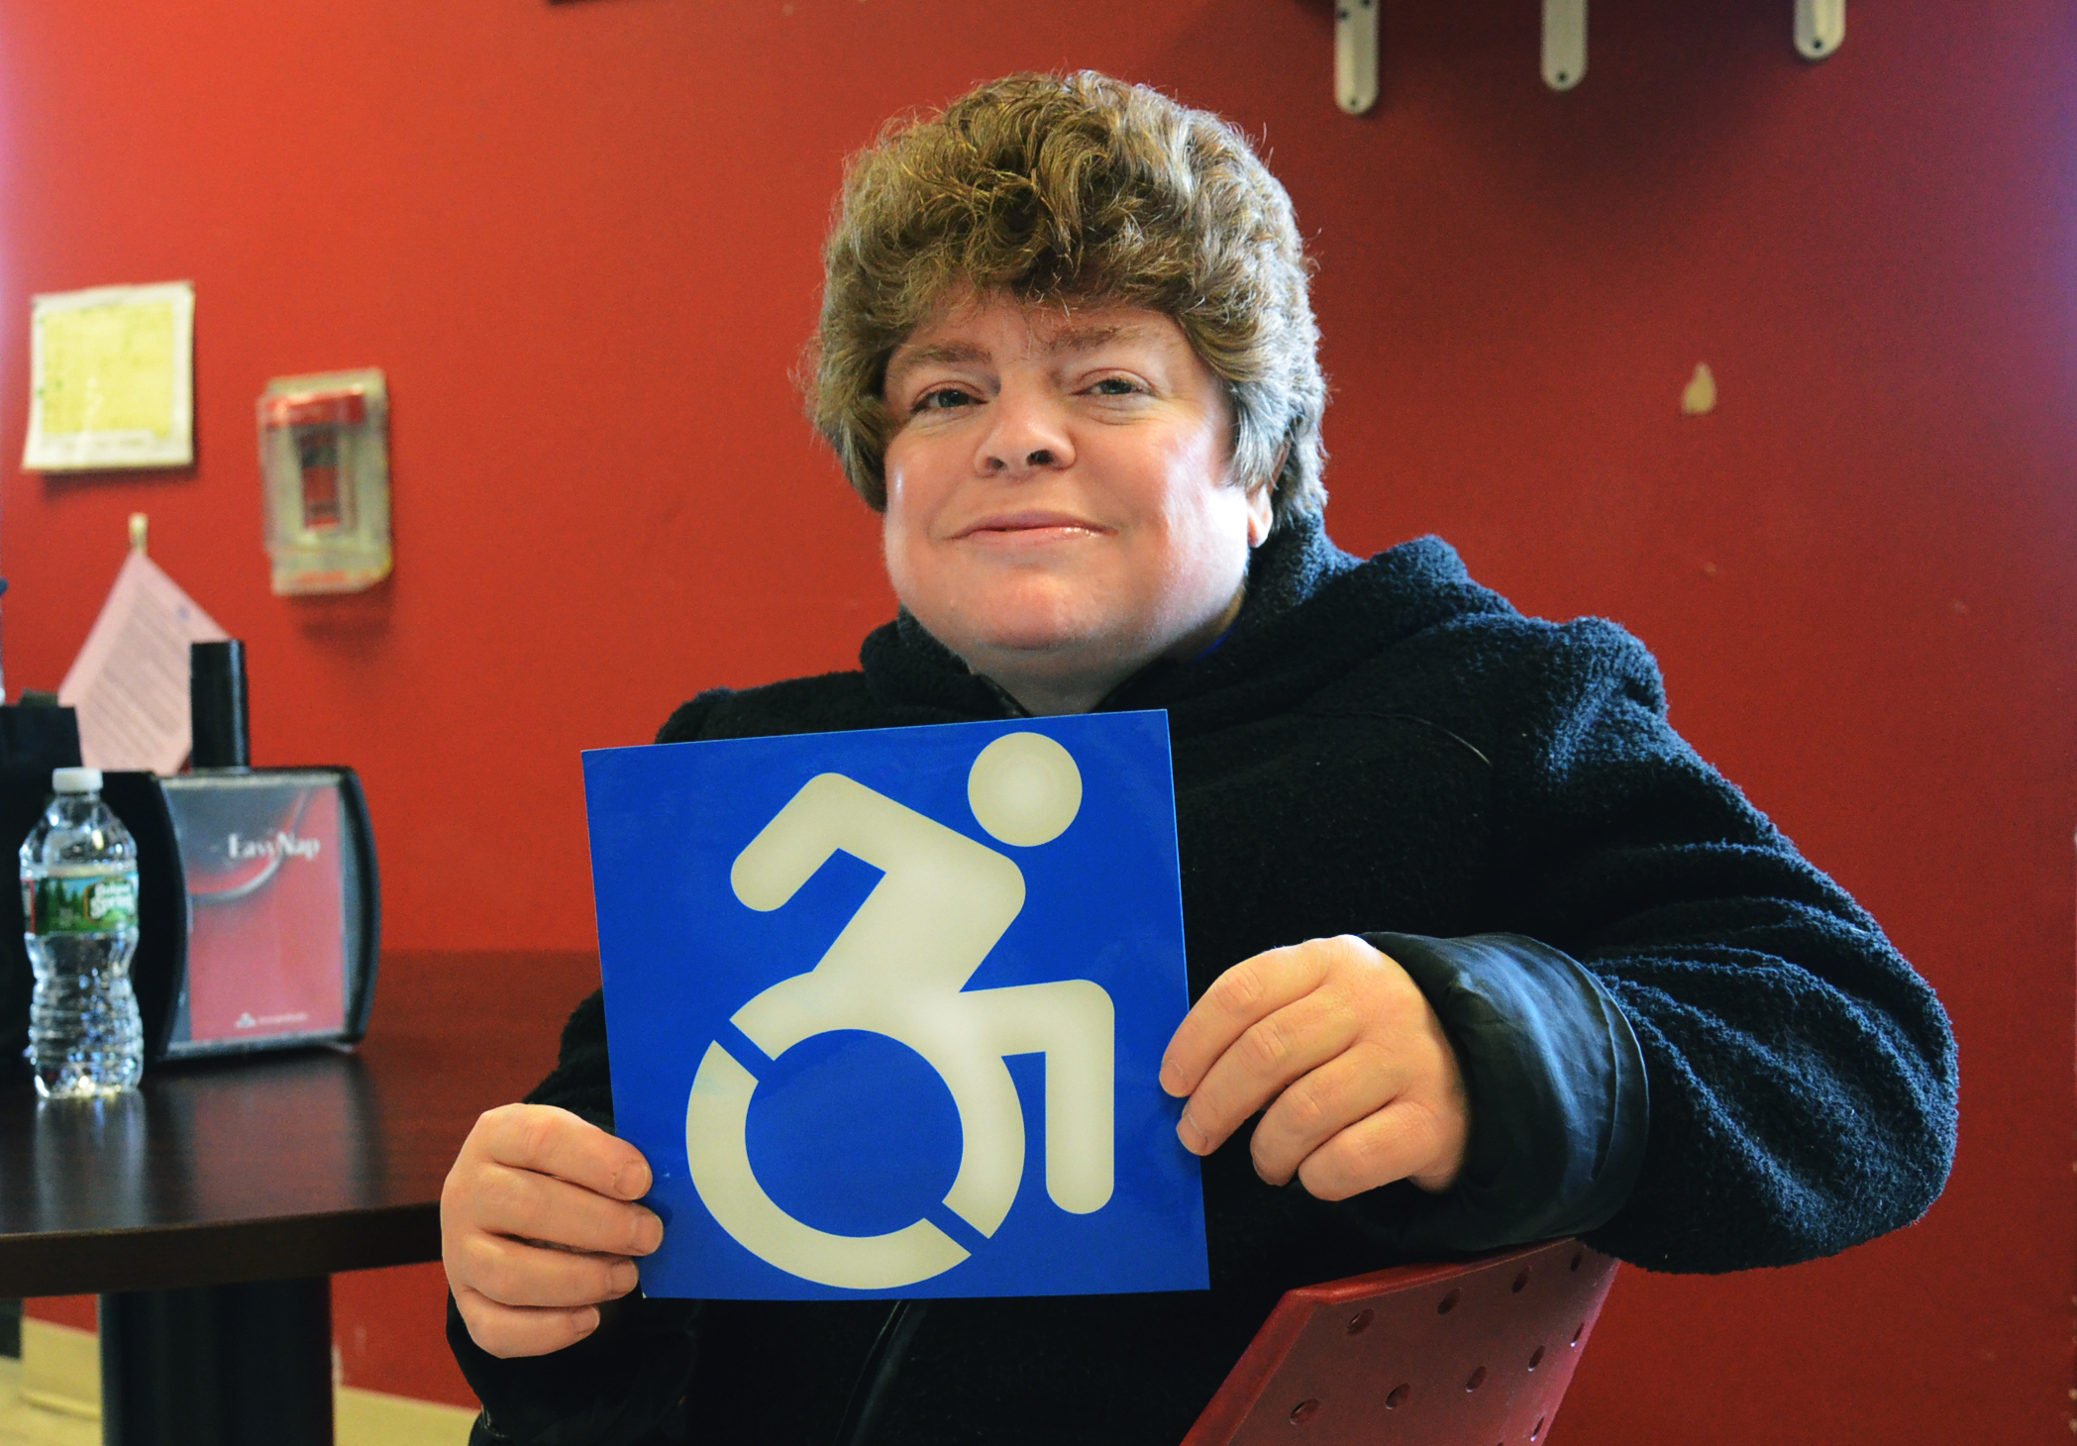

Slide 13
Keep in touch!
Cindy Thomas: cindy.thomas@umb.edu
Jeff Gentry: jgentry@triangle-inc.org
Notes:
Remind everyone that provider related resources have been posted within the webinar and are available at thinkwork.org

